Slide 1
Fundamentals of software engineering COM-560-MSC01 HW Milestones
Dev_team_ 2
Aravind Vudatha
Vamshi Gone
Lakshmi priya Mutyala

Slide 2
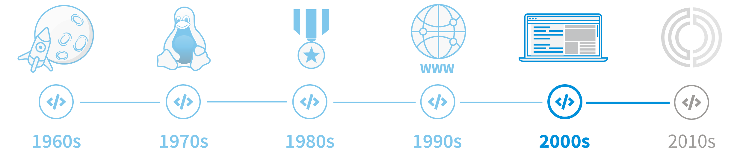
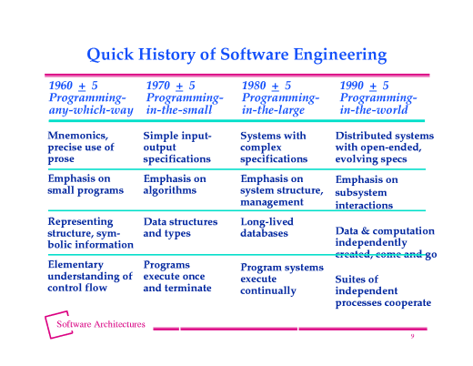
The History of software engineering
It was the late 1950s, and new computer technology was rapidly expanding, yet software engineering was a fledgling practice field.
This is due to the continual changes in software development, evolving standards, and new technologies.
The main driver of the adoption of software engineering was the need to improve automation and reduce the cost of software development.
The history of software engineering can be divided into three phases.
The first phase dates from the 1930s when the first software engineering books appeared.
The second phase is dated to the 1950s when the field emerged and became an independent academic discipline.
The third phase started around the late 1960s when large software companies began to use software engineers.

Slide 3
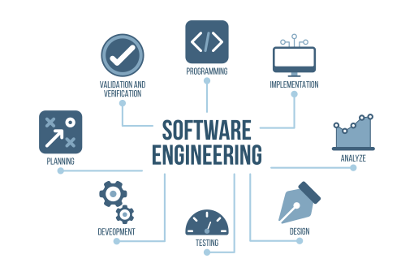
The History of software engineering
Software engineering has existed for decades, and with the advances in programming languages, technology, and software tools, it is only a matter of time before it will finally become a true engineering discipline.
The term software engineering is often used in ways incompatible with the practices of professional software developers and some academic community members.

Slide 4
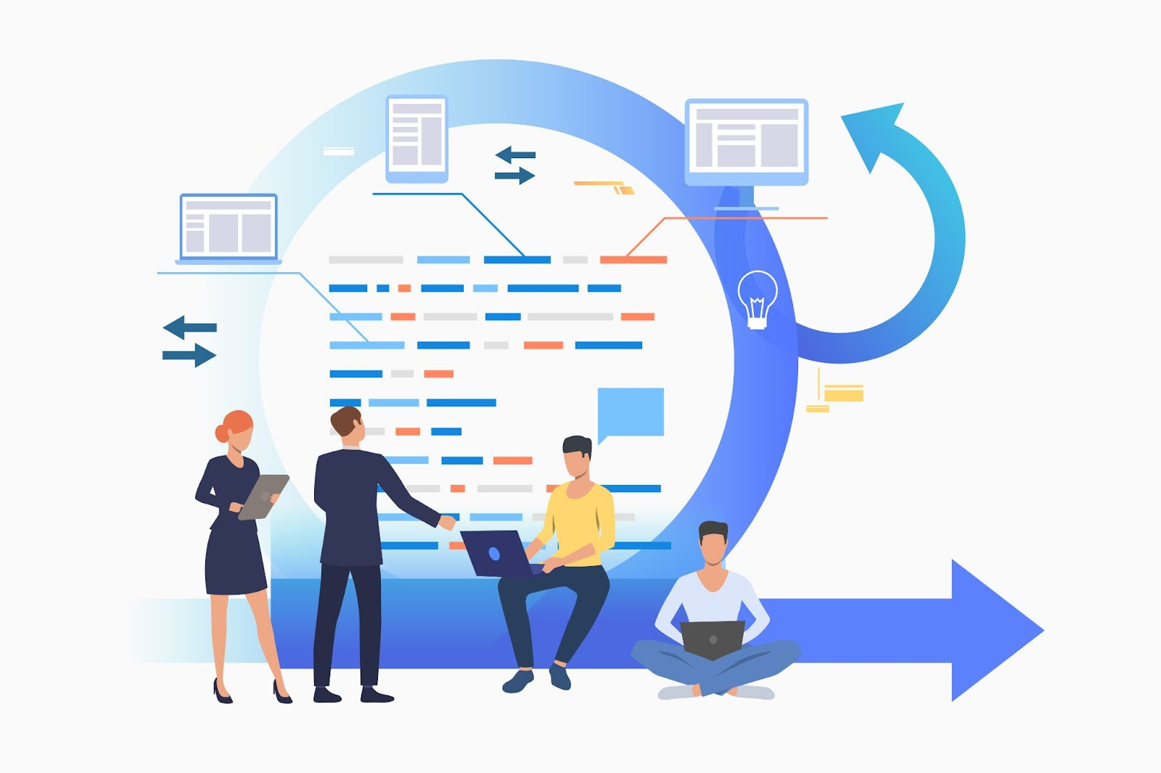
SDLC concepts
A software development life cycle is an iterative sequence of steps and activities used for developing software.
The life cycle involves a set of procedures to ensure software quality throughout its entire development.
It has been widely applied in some industries, such as financial institutions, telecoms, and insurance.
The model's primary purpose is to facilitate the creation of quality software that is consistent, understandable, and verifiable software.

Slide 5
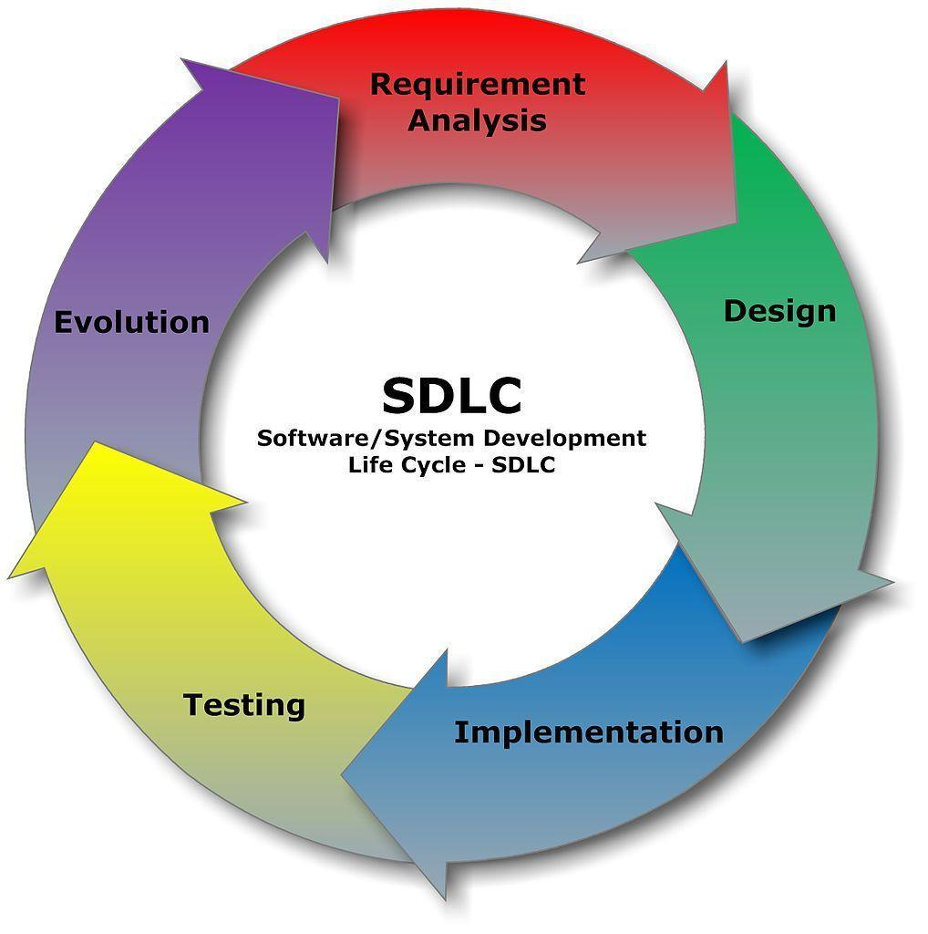
SDLC concepts
The Software Development Life Cycle starts with The Analysis phase, where we define the software requirements, the user behavior, and the solution to meet the requirements.
The next phase is the Planning phase, where we work together to plan the project and its features.
The third phase is the Design phase, where we work together to design the software. The design should follow the user behavior and the technology as the requirements decide.
The Software Development Life Cycle ends with the Implementation phase, where we implement the project and its features. It is the last phase; we may have to implement more than once, but when we think we have done enough testing to ensure the project meets the requirements.

Slide 6
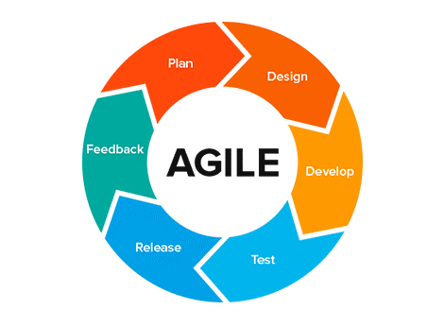
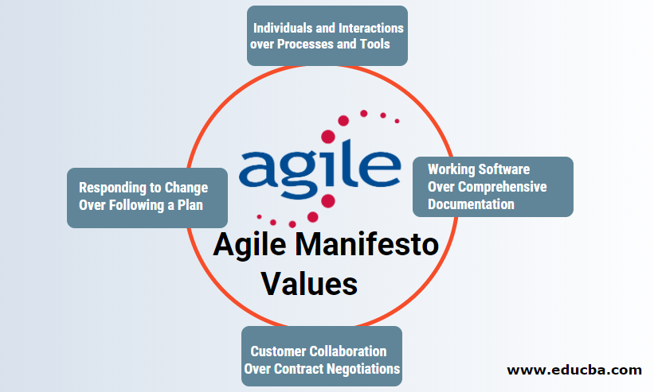
Agile / Agile Manifesto
Agile software development is a set of practices and philosophies that encourages, but does not require, unplanned incremental development.
Agile development is software development that encourages continuous, short cycles of planning, building, testing, and improving, resulting in a working product as fast as possible.
The Agile Manifesto defines agile as a project management philosophy requiring a team to produce working software through a continuous cycle of planning, building, testing, and improving the product.
The Agile Manifesto is a set of principles for software development, in particular software development in smaller and less formalized teams, as opposed to large, formally defined software projects where the code is developed and tested in phases (waterfall).

Slide 7
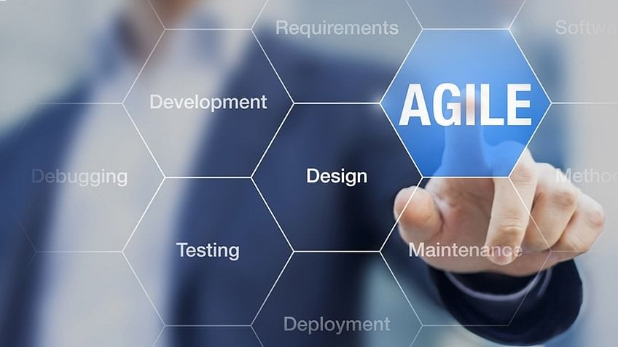
Agile / Agile Manifesto
Some of the principles and values are:
Individuals and interactions over processes and tools
Working software over comprehensive documentation
Customer collaboration over contract negotiation
Responding to change over following a plan
Eight distinct aspects of the agile values:
The self-organizing team
Communication
Feedback
Incremental development
Short iterations
Evolutionary development
Involvement of all affected Openness

Slide 8
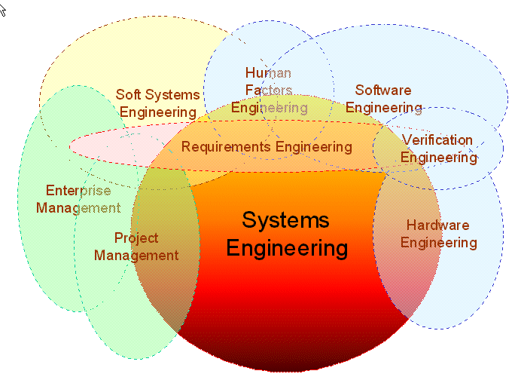
Systems Engineering
The core concept of systems engineering is the systematic analysis, design, implementation, and verification of complex systems, including their interfaces to each other and their environment.
Most customers will eventually use systems engineering to design or analyze their products, subsystems, or systems.
Systems engineering is a multidisciplinary discipline that uses engineering and business analysis to design systems and structures and involves evaluating, documenting, building, and testing a system to a defined level of functionality.
Systems engineering is the process of building systems by using a holistic approach. Systems engineering aims to maximize the effectiveness of the technology by optimizing it.
It also focuses on the overall picture of the system. As the name suggests, a system combines the parts that make up the whole.

Slide 9
References
Curcio, K., Santana, R., Reinehr, S., & Malucelli, A. (2019). Usability in agile software development: A tertiary study. Computer Standards & Interfaces, 64, 61-77.
Jamshidi, M. O. (2008). System of systems engineering-New challenges for the 21st century. IEEE Aerospace and Electronic Systems Magazine, 23(5), 4-19.
Kiv, S., Heng, S., Kolp, M., & Wautelet, Y. (2018). Agile manifesto and practices selection for tailoring software development: A systematic literature review. In Product-Focused Software Process Improvement: 19th International Conference, PROFES 2018, Wolfsburg, Germany, November 28–30, 2018, Proceedings 19 (pp. 12-30). Springer International Publishing.
Leau, Y. B., Loo, W. K., Tham, W. Y., & Tan, S. F. (2012). Software development life cycle AGILE vs traditional approaches. In International Conference on Information and Network Technology (Vol. 37, No. 1, pp. 162-167).

Slide 10
References
Lo, S. K., Lu, Q., Wang, C., Paik, H. Y., & Zhu, L. (2021). A systematic literature review on federated machine learning: From a software engineering perspective. ACM Computing Surveys (CSUR), 54(5), 1-39.
Munn, Z., Aromataris, E., Tufanaru, C., Stern, C., Porritt, K., Farrow, J., ... & Jordan, Z. (2019). The development of software to support multiple systematic review types: the Joanna Briggs Institute System for the Unified Management, Assessment and Review of Information (JBI SUMARI). JBI Evidence Implementation, 17(1), 36-43.
Nielsen, C. B., Larsen, P. G., Fitzgerald, J., Woodcock, J., & Peleska, J. (2015). Systems of systems engineering: basic concepts, model-based techniques, and research directions. ACM Computing Surveys (CSUR), 48(2), 1-41.
Saini, M., & Kaur, K. (2014). A review of open source software development life cycle models. International Journal of Software Engineering and Its Applications, 8(3), 417-434.

